Slide 1


Practical product sampling for single scattering in media
Keven Villeneuve, Adrien Gruson, Iliyan Georgiev, Derek Nowrouzezahrai
Notes:
Hi I’m Keven Villeneuve and I will be presenting our work “Practical product sampling for single scattering in Media”.

Slide 2
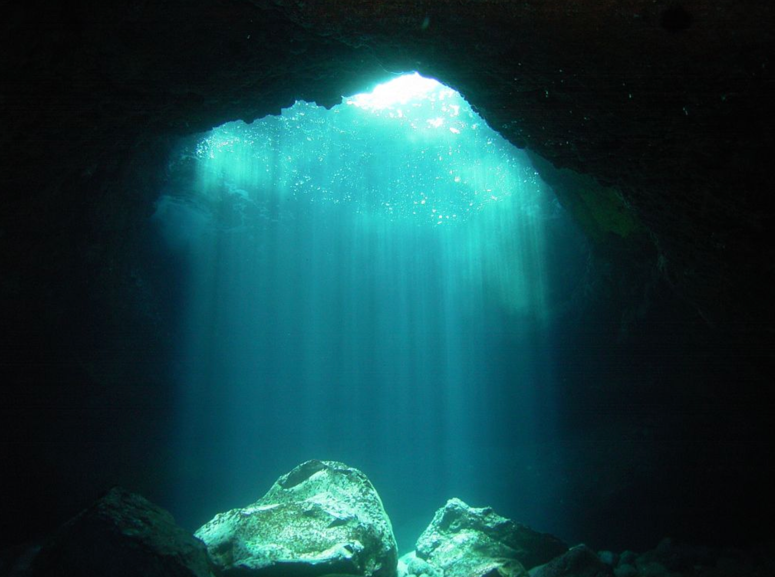
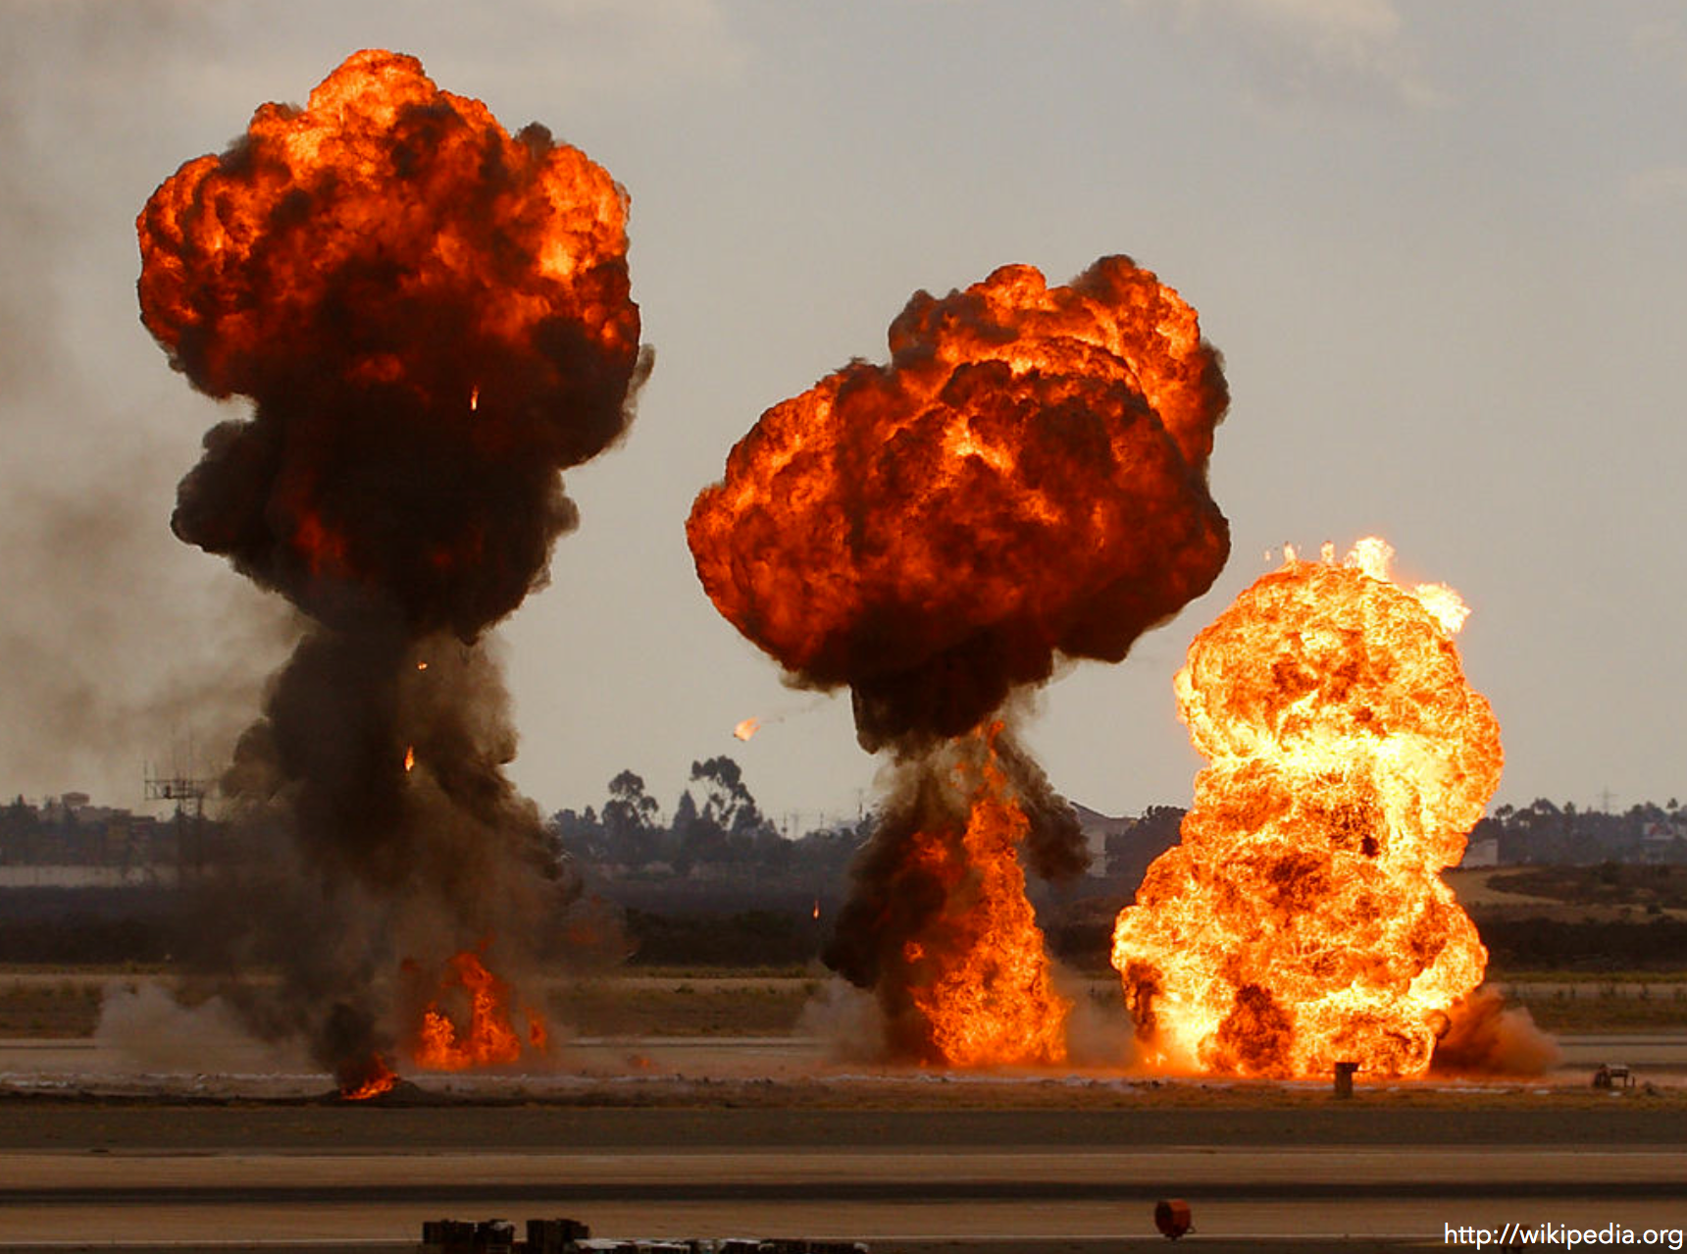

Motivation
Notes:
The main goal of our work is to render exciting and wonderful images like these more efficiently, by getting rid of the noise as much as possible.
While producing beautiful images, volumetric rendering can get quite complicated.
Light is affected by the medium, which means that contrary to surfaces rendering, we need to integrate the contribution of the light source along the ray, which is very expensive.

Slide 3

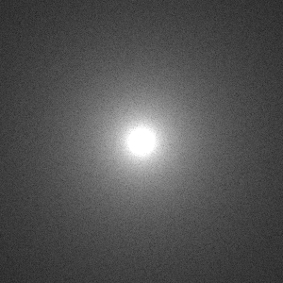
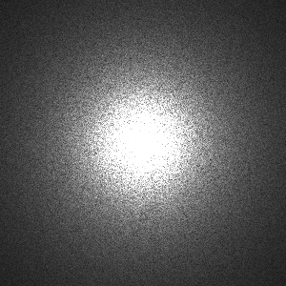


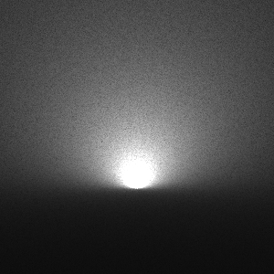
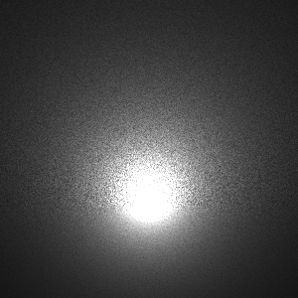
Motivation
Equi-angular [KF12]
Cosine Foreshortening
Phase function
Transmittance
…
Notes:
The problem is challenging even in a much simpler scene such as this one, where a single point light scatters in a homogeneous medium.

Slide 4
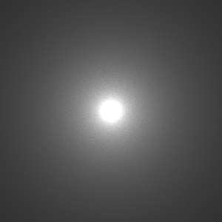
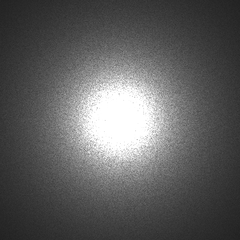
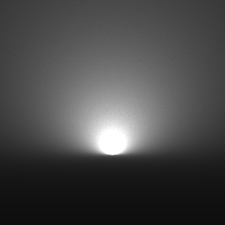
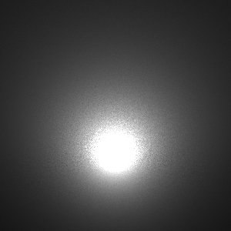
Motivation
Equi-angular [KF12]
Ours
Notes:
We will show how we can significantly improve this situation using our method.

Slide 5
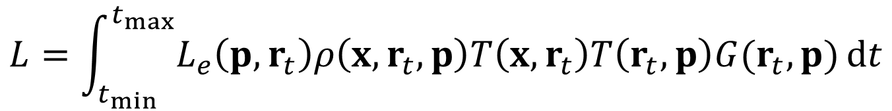
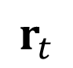
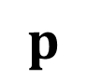

Background
$$p$$
Volumetric Path Tracing
$$x$$
$$r_{t}$$
$$L=\int_{t_{min}}^{t_{max}}{L_{e}\left(p, r_{t}\right)ρ\left(x,r_{t},p\right)T\left(x,r_{t}\right)T\left(r_{t},p\right)G(r_{t},p)}dt$$
Notes:
So in this work we focus on this much simpler context.
Without breaking generalization, we only consider the illumination of a point source directly scattering within a homogeneous media.
Here we assume that the light is inside the medium.
Our method can also be used for heterogeneous media as well but at the cost of more variance of course.

Slide 6
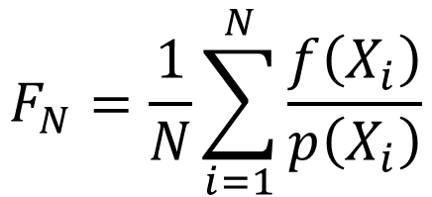
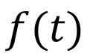
Background
$$p$$
Volumetric Path Tracing
$$x$$
$$r_{t}$$
$$L=\int_{t_{min}}^{t_{max}}{L_{e}\left(p, r_{t}\right)ρ\left(x,r_{t},p\right)T\left(x,r_{t}\right)T\left(r_{t},p\right)G(r_{t},p)}dt$$
$$F_{N}=\frac{1}{N}\sum_{i=1}^{N}{\frac{f\left(X_{i}\right)}{p\left(X_{i}\right)}}$$
$$f(t)$$
Notes:
We usually compute this integral using a Monte Carlo estimator.
The efficiency of this estimator can be improved by using suitable importance sampling techniques to choose a distance along the ray.
Even in this simpler situation the variance can be caused by many different factors:

Slide 7
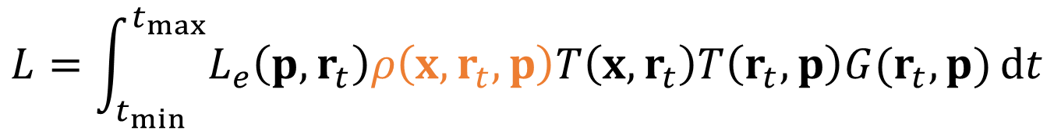
Background
Volumetric Path Tracing
$$L=\int_{t_{min}}^{t_{max}}{L_{e}\left(p, r_{t}\right)ρ\left(x,r_{t},p\right)T\left(x,r_{t}\right)T\left(r_{t},p\right)G(r_{t},p)}dt$$
$$F_{N}=\frac{1}{N}\sum_{i=1}^{N}{\frac{f\left(X_{i}\right)}{p\left(X_{i}\right)}}$$
$$f(t)$$
Notes:
First the anisotropy of the phase function.

Slide 8
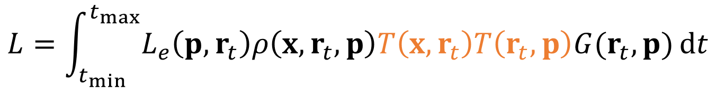
Background
Volumetric Path Tracing
$$L=\int_{t_{min}}^{t_{max}}{L_{e}\left(p, r_{t}\right)ρ\left(x,r_{t},p\right)T\left(x,r_{t}\right)T\left(r_{t},p\right)G(r_{t},p)}dt$$
$$F_{N}=\frac{1}{N}\sum_{i=1}^{N}{\frac{f\left(X_{i}\right)}{p\left(X_{i}\right)}}$$
$$f(t)$$
Notes:
There is also the transmittance (from the camera ray and from the light source) which attenuates the light along the ray.

Slide 9
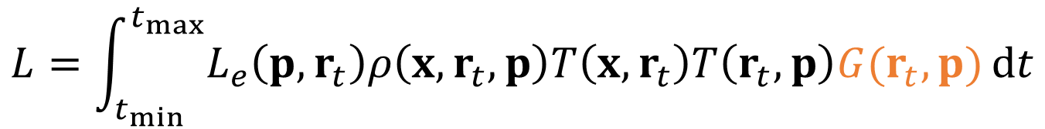
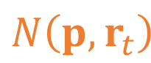
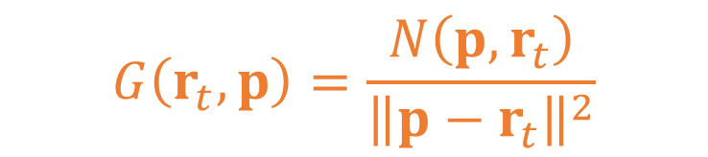
Background
Volumetric Path Tracing
$$p$$
$$N\left({p,r}_{t}\right)$$
$$r_{t}$$
$$L=\int_{t_{min}}^{t_{max}}{L_{e}\left(p, r_{t}\right)ρ\left(x,r_{t},p\right)T\left(x,r_{t}\right)T\left(r_{t},p\right)G(r_{t},p)}dt$$
$$G\left(r_{t},p\right)=\frac{N\left({p,r}_{t}\right)}{{\left\|{p−r}_{t}\right\|}^{2}}$$
$$F_{N}=\frac{1}{N}\sum_{i=1}^{N}{\frac{f\left(X_{i}\right)}{p\left(X_{i}\right)}}$$
$$f(t)$$
Notes:
And finally there is the geometric term, with the distance fall-off and the cosine foreshortening on the light source.
This term is represented by N in the equation.
An efficient sampling solution should try to take into account all of those terms and this is what we attempt in our work.
In particular, we are interested in importance sampling the product of all those terms.
Previously equi-angular sampling [KF12] proposed to importance sample the distance fall-off of the geometric term.

Slide 10
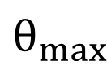
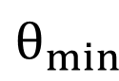
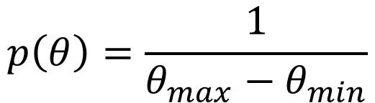
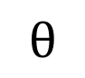
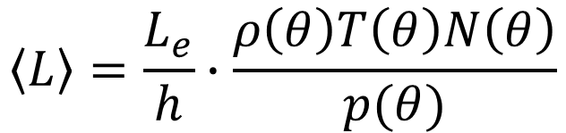
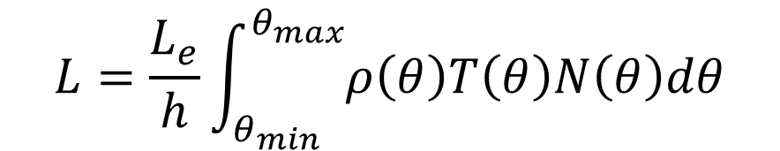
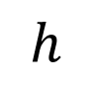
Related Work
Equi-angular Sampling [Kulla et Fajardo 2012]
$$L=\frac{L_{e}}{h}\int_{θ_{min}}^{θ_{max}}{ρ\left(θ\right)T\left(θ\right)N\left(θ\right)dθ}$$
$$θ_{min}$$
$$θ_{max}$$
$$h$$
$$θ$$
$$\left\langle L\right\rangle =\frac{L_{e}}{h}∙\frac{ρ\left(θ\right)T\left(θ\right)N\left(θ\right)}{p(θ)}$$
$$p\left(θ\right)=\frac{1}{θ_{max}−θ_{min}}$$
Notes:
By reformulating the problem into the angular domain, the distance fall-off factor moves out of the integral.
Meaning that this term will be importance sampled just by doing this transformation.
The sampling problem can then be simply seen as sampling an angle (theta) along the ray instead of a distance (t).
The angle is referenced from the light source and goes on either side of the ray.
Kulla and colleagues [KF12] propose to sample this angle uniformly between thetaMin and thetaMax, the beginning and end of the ray in the medium.
The resulting scheme is simple and completely analytical, making it a practical solution that can be easily integrated into industrial path tracers.

Slide 11
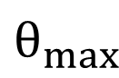
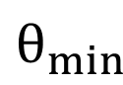
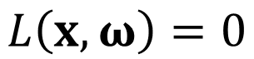

Related Work
Equi-angular Sampling [Kulla et Fajardo 2012]
Clamped cosine: $θ_{max},θ_{min}$
$$L=\frac{L_{e}}{h}\int_{θ_{min}}^{θ_{max}}{ρ\left(θ\right)T\left(θ\right)N\left(θ\right)dθ}$$
$$θ_{max}$$
$$\left\langle L\right\rangle =\frac{L_{e}}{h}∙\frac{ρ\left(θ\right)T\left(θ\right)N\left(θ\right)}{p(θ)}$$
$$θ_{min}$$
$$p\left(θ\right)=\frac{1}{θ_{max}−θ_{min}}$$
$$L\left(x,ω\right)=0$$
Notes:
In order to account for the case where the light source is back-facing the ray,
we can change the integration domain to exclude the regions where the light source does not contribute.
These new integration bounds can be computed based on where the light source’s normal (N) hits the ray (w).

Slide 12
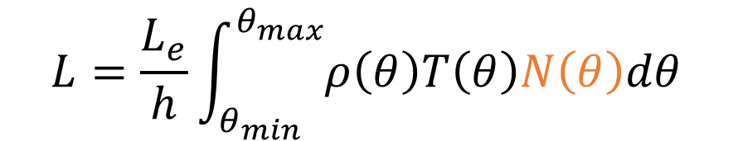
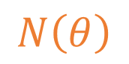
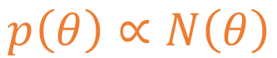
Analytical Point-normal Sampling
$$L=\frac{L_{e}}{h}\int_{θ_{min}}^{θ_{max}}{ρ\left(θ\right)T\left(θ\right)N\left(θ\right)dθ}$$
$$\left\langle L\right\rangle =\frac{L_{e}}{h}∙\frac{ρ\left(θ\right)T\left(θ\right)N\left(θ\right)}{p(θ)}$$
$$N\left(θ\right)$$
$$p\left(θ\right)∝N\left(θ\right)$$
Notes:
In our work we propose to extend equi-angular sampling [KF12] to account for the full geometric term by also including the cosine foreshortening term.
Like equi-angular sampling [KF12] we use the angular domain to implicitly importance sample the distance fall-off term.
In contrast, we sample an angle proportionally to the cosine term between the normal of the light source and the ray.

Slide 13
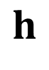


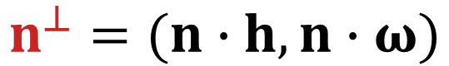

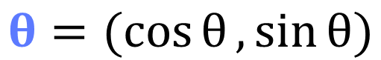
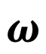
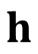

Analytical Point-normal Sampling
$$h$$
Parametrizing $N\left(θ\right)$ in local frame
$$ω$$
$$ω$$
$$θ=(\cos{θ},\sin{θ})$$
$$n^{⊥}=(n∙h,n∙ω)$$
$$θ$$
$$h$$
$$n^{⊥}$$
$$N\left(θ\right)=θ∙n^{⊥}=\left(n∙h\right)\cos{θ}+\left(n∙ω\right)\sin{θ}$$
Notes:
To design this new importance sampling scheme, we must first parametrize the cosine foreshortening term as a function of the angle (theta).
Notice the plane containing the ray (w) and the light source’s perpendicular distance on the ray (h).
Since the angle (theta) is referenced from (h), in this plane each components of the vector along the angle (theta) is simply the cosine and sinus of this angle.
The normal can be transformed to this plane by doing a projection of each of its components along (h) and (w).
We can then compute the cosine foreshortening term that we are looking for as the dot product between the vectors (theta) and (n_perp).

Slide 14

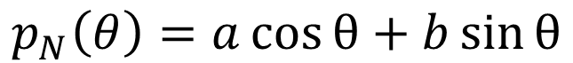
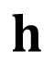


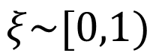
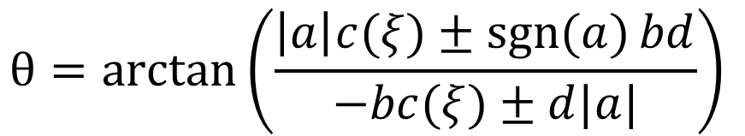
Analytical Point-normal Sampling
$$ω$$
$$θ$$
$$h$$
$$n^{⊥}$$
PDF
$$p_{N}\left(θ\right)=a\cos{θ}+b\sin{θ}$$
Integrate
$$P_{N}\left(θ\right)=a(sin{θ}−\sin{θ_{min}})−b(\cos{θ}−\cos{θ_{min}})$$
CDF
Invert
$$θ=\arctan\left(\frac{\left|a\right|c(ξ)±\operatorname{sgn}{(a)}bd}{−bc(ξ)±d|a|}\right)$$
$$ξ\sim [0,1)$$
Analytical sampling
Notes:
After this step, we derive the new sampling scheme using the so called “inversion method”.
This method necessitates to:
- First *integrate* the desired PDF to compute the CDF
- Normalize the PDF and CDF
- Finally, the CDF must be *inverted* to be able to sample from the target PDF
In our case, the resulting PDF can be analytically integrated and inverted.
a,b,c,d are constants that depend on the light source’s normal and the ray direction.
Xi is a random number from a uniform distribution between 0 and 1.
The inverse CDF has 2 solutions, only one of them is valid for any given situation,
the one that is between thetaMin and thetaMax.

Slide 15
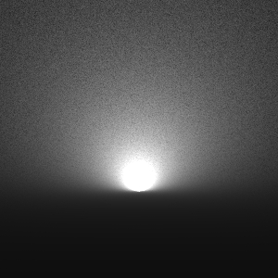
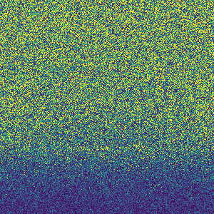
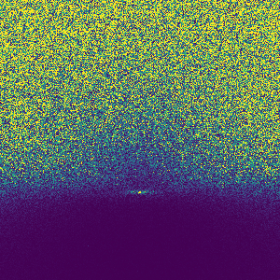

Equi-angular (17 spp)
Ours: $N$ (13 spp)
0.2
SMAPE
0.101
0.086
0.0
Notes:
We now show some results of this method.
First in a simple scene composed of a single point-normal light oriented up in an isotropic medium.
The inset shows the SMAPE error against equi-angular sampling on the left.
We can see that our method outperforms equi-angular sampling at equal time.
In this situation the only remaining noise is caused by the transmittance factors.

Slide 16
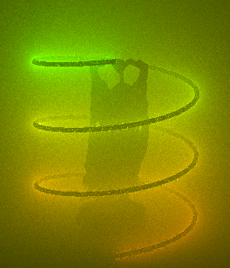
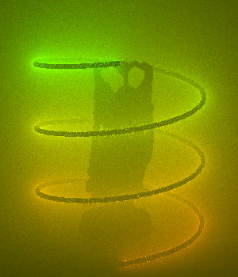

Equi-angular (43.9 sec)
Ours: $N$(44.9 sec)
Notes:
On a more complex scene with a mesh light such as this one, we get noticeable variance reduction compared to equi-angular sampling.
Especially around the light source where the cosine factor has more impact.
To better visualize the improvement … we can visualize the SMAPE error map.

Slide 17
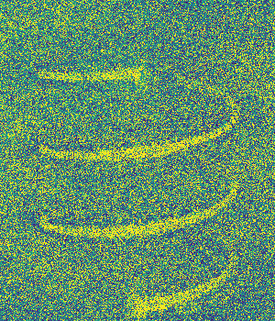
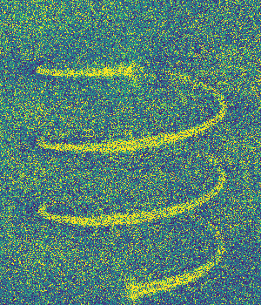

Equi-angular (43.9 sec)
Ours: $N$(44.9 sec)
0.2
SMAPE
0.0616
0.0514
0.0
Notes:
Once again we see that our method converges faster than equi-angular sampling.
Note that we use Adaptive Tree Splitting with a splitting factor of 0.04 in order to reduce the sources of noise as much as possible.
These images were rendered at 1 sample per pixel with anti-aliasing disabled.

Slide 18
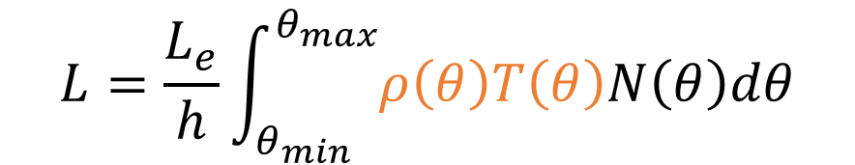

Remaining terms
$$L=\frac{L_{e}}{h}\int_{θ_{min}}^{θ_{max}}{ρ\left(θ\right)T\left(θ\right)N\left(θ\right)dθ}$$
$$θ$$
Notes:
We will now see how to importance sample the other terms of the volume rendering equation.

Slide 19


Remaining terms
$$L=\frac{L_{e}}{h}\int_{θ_{min}}^{θ_{max}}{ρ\left(θ\right)T\left(θ\right)N\left(θ\right)dθ}$$
$$θ_{hg}=θ+\frac{π}{2}$$
$$θ$$
Notes:
Similarly to the cosine term, we parametrize the phase function in the angular domain.
This is trivial to do since the phase function is already a function of an angle.
We use HG here for the anisotropic phase function.
The relation between the angle theta and the angle from the phase function is theta + pi/2 as can be seen on this diagram.

Slide 20







Remaining terms
$$L=\frac{L_{e}}{h}\int_{θ_{min}}^{θ_{max}}{ρ\left(θ\right)T\left(θ\right)N\left(θ\right)dθ}$$
$$t′$$
$$t′=h\sec\left(θ\right)$$
$$h$$
$$θ$$
$$t$$
$$t=h\tan\left(θ\right)+t_{h}$$
$$t_{h}$$
Notes:
The transmittance T(theta) can also be easily transformed to the angular domain by doing a little bit of trigonometry.

Slide 21





Remaining terms
$$θ$$
$$θ$$
$$ρ\left(θ\right)$$
$$T\left(θ\right)$$
Integrate
Invert (Numerical)
Integrate
Polynomial Approximation
Polynomial
Sampling
Notes:
Unfortunately, both transmittance and phase function cannot be integrated analytically, so we cannot use the inversion method as is.
Our solution is to approximate these terms using a polynomial approximation.
The solution to integral of polynomials is simple and well known.
It is also often the case that the CDF cannot be inverted analytically, one then resolves to using numerical root finding methods such as Newton-Raphson.

Slide 22




Approximated Transmittance/Phase function
Taylor Expansion
$$ρ\left(θ\right)$$
$$T\left(θ\right)$$
Notes:
In our work we choose to explore the use of Taylor series expansion to obtain a polynomial of order n that can be integrated.
Since it is a polynomial, the CDF is straightforward but not the inverse. For the inverse we use numerical inversion.
The curve in blue is the reference function while the curve in orange is the Taylor approximation.
In our case we find that an order 6 provides the best tradeoff between accuracy and computation time.
You can see on the figure that the approximation gets worse as we get away from the expansion point.
In some situations, the Taylor expansion can overshoot so badly that the PDF becomes negative, which makes it invalid to be used in a Monte Carlo estimator.
To be valid a PDF must not be negative and should not go to 0 when the function is not 0.
Thankfully, it only happens in a very particular region of the function.
To resolve this issue, we clamp our Taylor expansion beyond a certain angle (theta_clamp),
This angle is a function fitted on the PDF of the function.
Please see the paper for more details.

Slide 23



Approximated Transmittance/Phase function
$$T(θ)$$
$$ρ(θ)$$
Notes:
In some situations, the Taylor expansion can overshoot so badly that the PDF becomes negative, which makes it invalid to be used in a Monte Carlo estimator.
To be valid a PDF must not be negative and should not go to 0 when the function is not 0.
Thankfully, as this plot shows in red, it only happens in a very particular region of the function.
This figure represents the PDF of the Taylor expansion of a given term, on the top row transmittance and on the bottom the Phase function.
The zone in red is where the PDF is negative.
The X axis is the angle between the light normal and the ray.
For the top row, the Y axis is the distance between the light and a point on the ray.
While for the bottom row it is the phase function angle.
To resolve this issue, we clamp our Taylor expansion beyond a certain angle (theta_clamp),
This angle is a function fitted on this plot and can be seen as a dashed curve on the figure.

Slide 24



Equi-angular (16 spp)
Ours: $𝒯_{T}$(13 spp)
0.2
SMAPE
0.123
0.020
0.0
Notes:
On this slide, we show a comparison between this technique and equi-angular sampling at equal-time.
The figure on the right, rendered using our method is practically converged.
The only noise left comes from the error in the approximation of the Transmittance terms.

Slide 25



Approximated Product Sampling
$$p\left(θ\right)∝𝒯_{ρ}\left(θ\right)N\left(θ\right)$$
or
$$p\left(θ\right)∝𝒯_{T}\left(θ\right)N\left(θ\right)$$
Integrate
$$P\left(θ\right)$$
Invert (Numerical)
Semi-analytical Sampling
Notes:
We now have all the tools to importance sample the product of the geometric term N(theta) with the Taylor expansion T of a given function such as Transmittance or Phase Function.
We integrate the PDF or our Taylor product to obtain the CDF.
The CDF is a polynomial of high order and thus cannot be inverted analytically so we
default to use the Newton-Raphson method to sample from the target PDF.
Our newton solver only requires a few iterations (3-4) to converge to a solution on this CDF.

Slide 26
Equi-angular (17 spp)
Ours: $N$ (13 spp)
0.2
SMAPE
0.101
0.086
0.0
Notes:
This is the previous results we have shown for the point-normal light scene where we only sample with our analytical point normal scheme.

Slide 27


Ours: $𝒯_{T}∗N$ (9 spp)
Ours: $N$ (13 spp)
0.2
SMAPE
0.011
0.086
0.0
Notes:
And here this is the results with our approximate product of the taylor expansion of the transmittance and the point normal.
We can see that most of the noise disappears.

Slide 28



Equi-angular (43.9 sec)
Ours: $N$ (44.9 sec)
Ours: $𝒯_{T}∗N$ (49.7 sec)
0.0616
0.0514
0.0491
0.0
SMAPE
0.2
Notes:
On the buddha scene we obtain substantial variance reduction compared to equi-angular sampling as well.

Slide 29












Approximated Product Sampling
$$L=\frac{L_{e}}{h}\int_{θ_{min}}^{θ_{max}}{ρ\left(θ\right)T\left(θ\right)N\left(θ\right)dθ}$$
Do Taylor Expansion of $𝒯_{T∗P}$
Uses [Hart et al. 2020]’s idea
Bezier Warp
$$ξ^{′}$$
Our approximate product with polynomial
$$ξ$$
$$θ$$
$$[0,1)$$
$ℬ_{ρ}(𝒯_{T}∗N)$:
$$ρ\left(θ\right)$$
$$𝒯_{T}\left(θ\right)×N(θ)$$
$ℬ_{T}(𝒯_{ρ}∗N)$:
$$T\left(θ\right)$$
$$𝒯_{ρ}\left(θ\right)×N(θ)$$
Notes:
The remaining question is how we sample the product of all the terms together.
One potential solution is to do the Taylor expansion of the product of the transmittance and phase function, however this require a higher order polynomial.
A more practical solution is to use the idea developed by Hart and colleagues in 2020 inside their practical product sampling.
In this paper the authors propose to transform an initial random number using a Bezier warp.
This new random number xi prime is then used to do our approximate product like shown just before.
With this approach, we can, for example use a Bezier warp to model the phase function and handle the two-remaining terms with our technique.
Or we could use the transmittance as a warp.
The choice of which term to use in the warp depends on how strong the transmittance term is compared to the phase function one.
For now we pick the one that works the best in practice.

Slide 30







Equi-angular
Ours: $ℬ_{T}\left(𝒯_{ρ}\right)$
Equi-angular
Ours: $ℬ_{T}\left(𝒯_{ρ}∗N\right)$
72 spp
33 spp
69 spp
25 spp
0.262
0.038
0.143
0.045
Notes:
On these equal-time renders, we can see that variance is significantly reduced in both scenes when we use our method that takes into account all terms of the volume rendering equation.

Slide 31








Equi-angular
Ours: $N$
Ours: $ℬ_{T}\left(𝒯_{ρ}∗N\right)$
25 spp
23 spp
19 spp
0.1860
0.1825
0.1370
Notes:
Finally, we show results on another scene which contains a mesh light in a dense homogeneous medium.
In this scene, all three terms of the volume rendering equation have great impact on the illumination of the scene.
Our product sampling technique on the right performs the best.

Slide 32
Summary
Summary:
New analytical method to sample cosine foreshortening and distance falloff
Approximate product sampling via Taylor expansion
Full approximate product with one warp composition
Future work:
Specialize to planar lights, mesh lights, …
Extend to heterogeneous media
Handle refractive medium boundaries
Notes:
In summary
- we have developed a new analytical importance sampling method to sample the cosine foreshortening term and the distance fall-off of a point-normal light inside an homogeneous medium.
- we’ve also seen how Taylor expansion can be used as an alternative to Bezier warps to do product sampling.
- we have derived an approximate sampling scheme to sample the product of all the terms in the rendering equation using warp composition.
Interesting future work includes
specialization to planar lights, or mesh lights
or even extending our method to heterogeneous media.
But also handling refractive medium boundaries since we assume that we can easily construct a path that connects the light to the sampled point.
This concludes our talk, thanks for listening!

Slide 33

Thank you for your attention :)

